Slide 1

Article 2
Finance Committee Report to Town Meeting
Annual Town Meeting
May 5, 2025

Slide 2

Select Board & School Committee Priorities
The Finance Committee’s focus is both short-term and long-term
We prepare the Annual Operating Budget that is in your warrant and will be discussed in Article 13
We review and vote on all Town Meeting and Special Town Meeting warrant articles that have a financial implication to the Town
We evaluate the financial implications of all capital projects, including the School Master Plan, funding for significant building renovations such as the Department of Public Works Facilities, the Public Safety Buildings and school renovations
We consider, study and deliberate on how Needham’s Capital Plans and Major Project Initiatives can be financed in a way that (a) achieves the Select Boards Goals, (b) maintains the Town’s financial flexibility and (c) carefully considers the tax burden to its residents.

Slide 3
2025 Debt Financing Outlook
The Director of Finance and his staff have prepared a report called 2025 Debt Financing Outlook
https://www.needhamma.gov/ArchiveCenter/ViewFile/Item/13754
(The 2025 Debt Financing Outlook begins on page 14)
The Report was presented to the Select Board on their meeting on April 22, 2025 and is available at the above link.
This is a tremendous amount of work, analysis and thoughtful preparation and we thank the Director of Finance and his staff for preparing this report. This is an invaluable tool for the Finance Committee.

Slide 4
Debt Management Policies
From the Select Board’s Debt Management Policies (Last Revised 1/9/2024)
The Town will allocate or reserve 3% of projected General Fund revenue (property taxes less debt exclusions, state aid, and local receipts) for debt service. Referred to as - Debt Within the Levy
The Town will strive to limit total debt service, including debt exclusions and self-supporting debt, to 10% of gross revenues.
Referred to as – Excluded Debt
Purpose: to help ensure that the town borrows money only for appropriate capital projects
Maintain financial discipline
Protects the Town’s AAA credit rating
Manages long term planning
Ensures intergenerational equity

Slide 5
Identified Future Capital Projects
Funding Year | Project | Estimated Debt Authorization | Debt Group
2026 | Infiltration and Inflow | $ 1,000,000.00 | Sewer Enterprise
2026 | Library Renovation Young Adult Area | $ 2,386,000.00 | GF Within Levy
2026 | Public Works Phase 1 Construction | $ 19,600,000.00 | GF Within Levy/Enterprise 10%
2026 | Quiet Zone Safety Upgrades | $ 4,500,000.00 | GF Within Levy
2027 | Center at the Heights Upgrades | $ 1,705,000.00 | GF Within Levy
2027 | Cooks Bridge Sewer Pump Station | $ 3,500,000.00 | Sewer Enterprise
2027 | Public Works Phase 2 Design | $ 2,496,000.00 | GF Within Levy
2027 | Water Supply Development | $ 3,050,000.00 | Water Enterprise
2027 | Action Park & Pickleball Court | $ 3,000,000.00 | GF Within Levy
2027 | Pollard Middle School Project | $ 248,932,000.00 | Excluded
2028 | Fire Engine Aerial | $ 2,167,951.00 | GF Within Levy
2028 | Library Renovation Children's Area | $ 2,990,000.00 | GF Within Levy
2028 | Theatrical Lighting, Sound & Rigging Repairs High School | $ 2,070,617.00 | GF Within Levy
2029 | Public Works Phase 2 Construction | $ 21,560,000.00 | GF Within Levy/Enterprise 10%
2030 | Fire Engine | $ 1,540,393.00 | GF Within Levy
2030 | Library Renovation Circulation Area & Multipurpose Room | $ 2,060,000.00 | GF Within Levy
2030 | Public Works Phase 3 Design | $ 3,300,000.00 | GF Within Levy
2030 | Sewer Main Replacements Phase 3 | $ 15,400,000.00 | Sewer Enterprise
2031 | Public Works Phase 3 Construction | $ 22,000,000.00 | GF Within Levy
2033 | Sewer Main Replacements Phase 4 | $ 6,900,000.00 | Sewer Enterprise
2035 | Mitchell School Design | $ 2,659,000.00 | Excluded
2035 | Mitchell School Construction | $ 119,001,600.00 | Excluded
$248.9 is the debt that the Town will need to raise, not the total project cost of $311.2 million

Slide 6
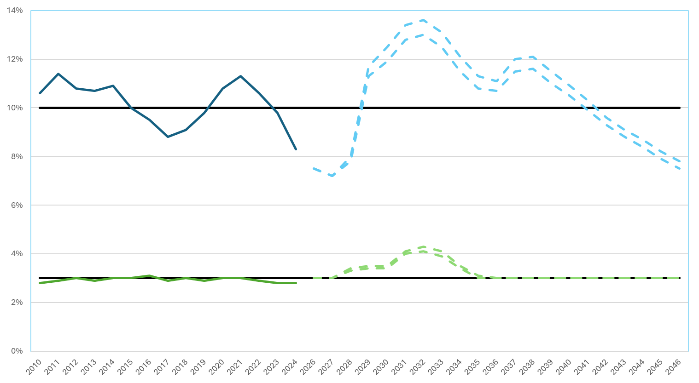
Debt Service Ratios Outlook
Projected* Total Debt Service %
Historical Total Debt Service %
Projected* General Fund Debt Service %
Historical General Fund Debt Service %
*projections assume 4% revenue growth and 5.5%-6.25% interest rate

Slide 7
Projected Annual Tax Impact from Pollard
Fiscal Year | Current Excluded Debt Obligations | Pollard School | Total
2025 | $ 890 | $ - | $ 890
2026 | $ 797 | $ - | $ 797
2027 | $ 732 | $ - | $ 732
2028 | $ 685 | $ 147 | $ 832
2029 | $ 630 | $ 1,250 | $ 1,880
2030 | $ 549 | $ 1,699 | $ 2,248
2031 | $ 533 | $ 1,952 | $ 2,485
2032 | $ 518 | $ 2,040 | $ 2,558
2033 | $ 503 | $ 1,993 | $ 2,496
2034 | $ 441 | $ 1,946 | $ 2,387
2035 | $ 432 | $ 1,899 | $ 2,331
2036 | $ 422 | $ 1,852 | $ 2,274
2037 | $ 413 | $ 1,805 | $ 2,218
2038 | $ 359 | $ 1,758 | $ 2,117
2039 | $ 350 | $ 1,710 | $ 2,060
2040 | $ 338 | $ 1,663 | $ 2,001
2041 | $ 249 | $ 1,616 | $ 1,865
2042 | $ 168 | $ 1,569 | $ 1,737
Fiscal Year | Current Excluded Debt Obligations | Pollard School | Total
2043 | $ 114 | $ 1,522 | $ 1,636
2044 | $ 110 | $ 1,475 | $ 1,585
2045 | $ 42 | $ 1,428 | $ 1,470
2046 | $ - | $ 1,380 | $ 1,380
2047 | $ - | $ 1,333 | $ 1,333
2048 | $ - | $ 1,286 | $ 1,286
2049 | $ - | $ 1,239 | $ 1,239
2050 | $ - | $ 1,192 | $ 1,192
2051 | $ - | $ 1,145 | $ 1,145
2052 | $ - | $ 1,098 | $ 1,098
2053 | $ - | $ 1,050 | $ 1,050
2054 | $ - | $ 1,002 | $ 1,002
2055 | $ - | $ 955 | $ 955
2056 | $ - | $ 908 | $ 908
2057 | $ - | $ 861 | $ 861
2058 | $ - | $ 739 | $ 739
2059 | $ - | $ 167 | $ 167
2060 | $ - | $ 157 | $ 157

Slide 8
Debt Financing Outlook
Exempted Debt History
Broadmeadow, Eliot, High Rock, Newman Preschool (2000)
High Rock/Pollard School (2007)
High School (‘88.’00,’03,’05)
Land Purchases (1988, 2000)
Landfill (1998)
Library (2003)
Sunita Williams School and Land (2016)
Newman School (1996, 2009)
Public Safety Building, Police/Fire HQ and #2 (‘88’18)
Pollard School (1992)
Transfer Station (1988
Total of all Debt Exclusion Projects - $325 million
Pollard Middle School - $311.2 million
$248.9 million debt exclusion

Slide 9
Debt Financing Outlook
Renovation of our Schools, maintaining and improving the Town’s infrastructure and services and encouraging new growth is important to achieve the Select Board and School Committee stated goals
The cost of the Pollard Middle School project alone is likely to
Increase the Town’s debt ratios above the 10% excluded debt levels for several years and above the 3% debt within the levy limit without using the debt stabilization fund to “smooth out” debt service during that time.
Increase residential tax rates by $2,000, with total excluded on a residential tax bill of $2,558 at the projected peak year in 2032.
Funding for Design ($31.5 million) and Construction ($279.6 million) is anticipated for October 2026 Fall Town Meeting
We have important discussions ahead of us to determine how to best renovate our school and municipal buildings and services while maintaining the Town’s financial flexibility and minimizing the burden on our taxpayers.
Pollard Middle School - $311.2 million
$248.9 million debt exclusion

Slide 10
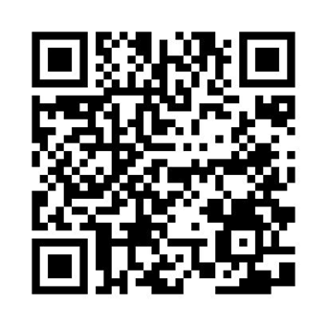
Debt Financing Outlook
To access the repot- 2025 Debt Financing Outlook- Use this QR code and go to page 14

