Slide 1

Article 13
Appropriate the FY2026 Operating Budget
Annual Town Meeting
May 5, 2025

Slide 2

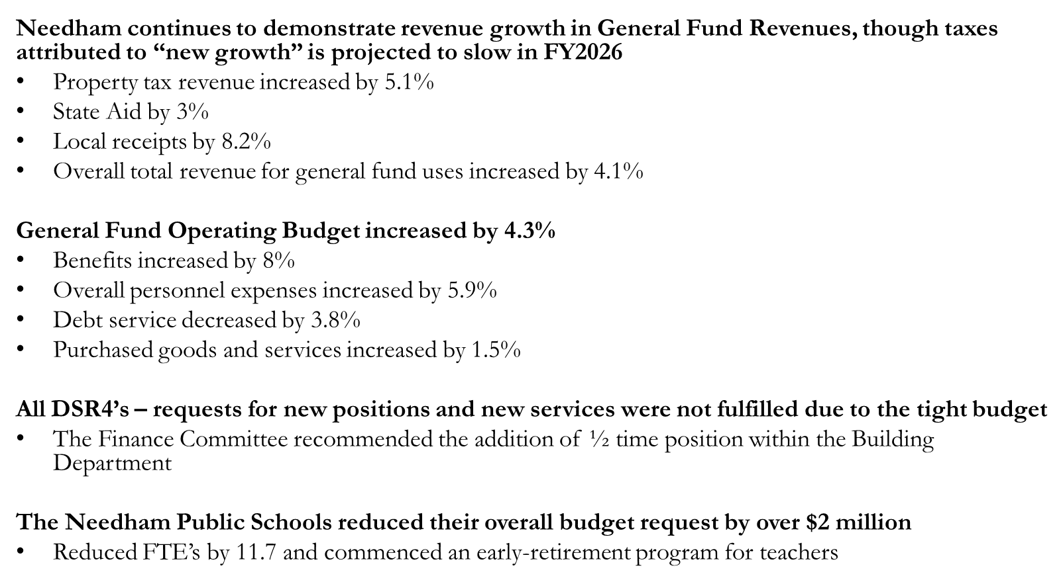
Overview

Slide 3
Revenue ($ millions)
 | FY2025 | FY2026 | % change
Property Taxes | $192.4 | $202.3 | 5.14%
State Aid | $16.2 | $16.7 | 3.02%
Local Receipts | $15.4 | $16.7 | 8.17%
Other (free cash, overlay surplus) | $22.9 | $21.4 | -6.48%
Reimbursements (CPA, Enterprise Funds | $2.2 | $2.1 | -1.76%
Available for General Fund | $249.0 | $259.1 | 4.06%

Slide 4
General Fund Allocations ($ millions)
Article 2
Finance Committee Report to Town Meeting
 |  |  | General Fund Allocations
TOTAL GENERAL FUND |  |  | $257.0
Cash Capital |  |  | $13.4
Financial Warrant Articles |  |  | $4.0
Transfers |  |  | $1.3
Other Uses
TOTAL FY26 PROPOSED OPERATING BUDGET |  |  | $235.9
Annual Town Meeting
May 5, 2025

Slide 5
Major Expense Type ($ millions)
 | FY2025 | FY2026 |  | % chg |  | % FY25 Budget | % FY26 Budget
Personnel
Salaries | $125.7 | $132.2 |  | 5.2% |  | 55.6% | 56.1%
Benefits | $41.1 | $44.5 |  | 8.0% |  | 18.2% | 18.8%
Personnel Total | $166.9 | $176.7 |  | 5.9% |  | 73.8% | 74.9%
Debt Service | $17.5 | $16.8 |  | -3.8% |  | 7.7% | 7.1%
Purchased Goods & Services | $41.7 | $42.3 |  | 1.5% |  | 18.4% | 17.9%
Total | $226.0 | $235.8 |  | 4.3% |  | 100.0% | 100.0%
Annual Town Meeting
May 5, 2025

Slide 6
Townwide Expenses - Major Departments
($ millions)
DEPARTMENT |  |  | FY2025 |  | FY2026 |  | % Chg
Needham Public Schools & Minuteman |  |  | $99.3 |  | $104.3 |  | 5.0%
Needham Public Schools (IT) |  |  | $1.9 |  | $2.5 |  | 31.8%
Townwide Expenses |  |  | $67.3 |  | $69.8 |  | 3.8%
Public Safety |  |  | $22.5 |  | $23.1 |  | 2.4%
Public Facilities & Public Works |  |  | $22.5 |  | $23.1 |  | 2.6%
General Government |  |  | $5.7 |  | $5.8 |  | 3.0%
Community Services |  |  | $6.9 |  | $7.3 |  | 5.3%
TOTAL EXPENSES |  |  | $226.1 |  | $235.9 |  | 4.3%
Annual Town Meeting
May 5, 2025

Slide 7

Townwide Expenses - % Operating Budget

Slide 8
Stabilization Fund Balances ($ millions)
Fund | March 23, 2025 Balance | Recommended Target
Athletic Facility Improvement Fund | $202,706 | $2,000,000
Capital Equipment Fund | $1,705,752 | The estimated cost of 1 fire engine and 1 fire ladder truck
Capital Facility Fund | $2,176,406 | 1.5% of the insured value of Town owned buildings
Debt Service Stabilization Fund | $2,429,662 | 2 Years of Gen. Fund Debt Service within the Levy or 5% of total General fund revenues
Opioid Stabilization Fund | $359,063 | Opioid settlement payments are credited to the Fund
Stabilization Fund | $4,894,488
Stormwater Stabilization Fund | $495,779 | 100% of stormwater mitigation assessments
Annual Town Meeting
May 5, 2025

Slide 9
Appropriations to Stabilization Funds
Town Meeting | Fund | Appropriation
May STM 2025 | Capital Equipment Fund | $161,128
May ATM 2025 | Capital Facility Fund | $435,138
May ATM 2025 | Athletic Facilities | $23,725
May ATM 2024 | Athletic Facilities | $68,743
May ATM 2023 | Athletic Facilities | $33,533
May STM 2023 | Capital Improvement | $85,556
Oct ATM 2022 | Capital Improvement | $351,662
May STM 2022 | Athletic Facilities | $85,659
Oct STM 2021 | Athletic Facilities | $674,900
May STM 2021 | Athletic Facilities | $30,815
May ATM 2019 | Athletic Facilities | $75,000
May STM 2019 | Capital Improvement | $166,612
May ATM 2018 | Athletic Facilities | $63,378
May ATM 2018 | Capital Improvement | $141,413
May ATM 2018 | Capital Facilities | $1,817,000
May ATM 2017 | Athletic Facilities | $1,295,000
May ATM 2017 | Capital Improvement | $28,051
May ATM 2017 | Debt Service | $1,091,874
May ATM 2016 | Athletic Facilities | $994,496
May ATM 2016 | Debt Service | $612,595
May STM 2016 | Capital Improvement | $29,296
May STM 2016 | Athletic Facilities | $320,186
May STM 2016 | Debt Service | $320,186

Slide 10
Use of Free Cash in Operating Budget
Free Cash – The free cash balance is a function of actual revenue collections greater than the estimates and expenditures less than appropriations. Free cash varies from year to year, and it has been the Town’s policy to use free cash not as a supplemental revenue source, but to improve reserves, invest in capital assets or to support short duration projects. Free cash is used to support the operating budget the lesser of 2% of the budget turnback of the prior fiscal year, or or the actual amount returned
Year | Final Budget | Free Cash Funding Budget | FC % Budget
FY 2014 | $124,101,249 | $1,619,224 | 1.3%
FY 2015 | $129,531,899 | $2,032,765 | 1.6%
FY 2016 | $136,570,837 | $1,941,264 | 1.4%
FY 2017 | $144,396,032 | $1,763,165 | 1.2%
FY 2018 | $153,184,148 | $2,689,482 | 1.8%
FY 2019 | $162,736,704 | $2,506,298 | 1.5%
FY 2020 | $178,260,006 | $2,068,301 | 1.2%
FY 2021 | $190,247,810 | $3,208,040 | 1.7%
FY 2022 | $195,800,817 | $3,527,570 | 1.8%
FY 2023 | $206,188,160 | $3,625,000 | 1.8%
FY 2024 | $214,275,097 | $3,597,105 | 1.7%
FY 2025 | $226,151,668 | $4,081,603 | 1.8%
FY 2026 | $235,925,907 | $4,245,792 | 1.8%

